Slide 1
Lecture 2: Visual Display of Data
Overview: In addition to considering various summary statistics, it is also common to consider some visual display of the data
Outline:
  Histograms
  Scatter Plots
  Assignment

Slide 2
Frequency Distributions
1. Histograms
Consider the experiment of measuring the leaf surface area (LSA) of a certain type of plant in a certain location
It’s possible that we could make tens of thousands of measurements and it’s possible that we obtain several “repeat” measurements for various values
For example, we may find that 1057 of the plants we observed had LSA 35 in² and 239 of the plants we observed had LSA 13 in²; and so on
If we were to plot the LSA vs. the frequency that number was observed, we would obtain a frequency distribution

Slide 3
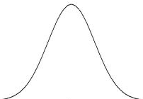
Normal Distribution
1. Histograms
There’s a good chance our plot may look like this:
This is the familiar “bell-curve” – a normal distribution
1057
frequency
LSA (in²)
35

Slide 4
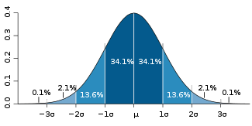
Normal Distribution
1. Histograms
If the data are normally distributed then, ≈68.3% of the values are within 1 standard deviation of the mean; ≈95.4% within 2 SDs; ≈99.7% within 3 SDs
In any distribution, smaller σ implies data are closer together and larger σ implies data are spread further apart

Slide 5
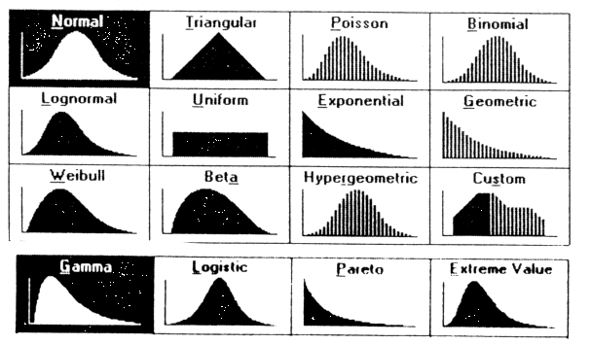
Probability Distributions
1. Histograms
There are many different probability distributions:
As can be seen here, the type of underlying variable- discrete or continuous- determines the type of distribution function- probability mass function or probability distribution function

Slide 6
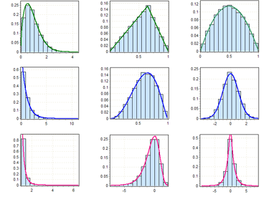
Probability Distributions & Histograms
1. Histograms
(Back to our experiment) Realistically, we won’t obtain enough measurements for our distribution to be a nice, smooth curve. A histogram is an estimate of the probability distribution of a continuous variable:

Slide 7
Constructing a Histogram
1. Histograms
Decide on the number of classes (bars) for the histogram
  Typically 10-20, but for a small dataset, 4-6
Determine the width of the classes (CW)
  CW = (Range) / (# classes) rounded up to precision of data
Select the smallest observed value as the lower limit of the first class and add multiples of the CW from step (2) to obtain the lower (not upper!) limits for each class
To find the upper class limits, add the CW to the lower class limits and subtract from this the precision of the data
  So if the CW is 0.3 and the lower limit of the first class is 3.7, then the upper class limit for the first class is 3.7 + .3 -.1 = 3.9
  There is a gap between the upper limit of one class and the lower limit of the next; the gap width is the precision of the data
The class boundaries will be the midpoint of these gaps

Slide 8

Example 2.2 Histogram for Black Bear Data
1. Histograms
In 2002, Katie Settlage and her field research team collected the following weights for female black bears in the southern Appalachians:
where the weight is given in pounds. Let’s go through the steps of constructing a histogram for this set of data.

Slide 9
Example 2.2 Histogram for Black Bear Data
1. Histograms
Decide on the number of classes (bars) for the histogram:
This is small data set- 24 points- so we choose 6 classes
Determine the width of the classes (CW):
CW = (Range) / (# classes) rounded up to precision of data
= (150 – 38) / 6 = 18.66… => 19

Slide 10
Example 2.2 Histogram for Black Bear Data
1. Histograms
Select the smallest observed value as the lower limit of the first class and add multiples of the CW from step (2) to obtain the lower (not upper!) limits for each class
Class | Lower
1 | 38
2
3
4
5
6

Slide 11
Example 2.2 Histogram for Black Bear Data
1. Histograms
Select the smallest observed value as the lower limit of the first class and add multiples of the CW from step (2) to obtain the lower (not upper!) limits for each class
Class | Lower
1 | 38
2 | 57
3
4
5
6

Slide 12
Example 2.2 Histogram for Black Bear Data
1. Histograms
Select the smallest observed value as the lower limit of the first class and add multiples of the CW from step (2) to obtain the lower (not upper!) limits for each class
Class | Lower
1 | 38
2 | 57
3 | 76
4 | 95
5 | 114
6 | 133

Slide 13
Example 2.2 Histogram for Black Bear Data
1. Histograms
To find the upper class limits, add the CW to the lower class limits and subtract from this the precision of the data
Class | Lower | Upper
1 | 38 | 56
2 | 57 | 75
3 | 76 | 94
4 | 95 | 113
5 | 114 | 132
6 | 133 | 151

Slide 14
Example 2.2 Histogram for Black Bear Data
1. Histograms
The class boundaries will be the midpoint of the gaps between the upper and lower boundaries
Class | Lower | Upper | Lower Boundary | Upper Boundary
1 | 38 | 56 | 37.5 | 56.5
2 | 57 | 75 | 56.5 | 75.5
3 | 76 | 94 | 75.5 | 94.5
4 | 95 | 113 | 94.5 | 113.5
5 | 114 | 132 | 113.5 | 132.5
6 | 133 | 151 | 132.5 | 151.5

Slide 15
Example 2.2 Histogram for Black Bear Data
1. Histograms
We need to count the frequencies for each class
Class | Lower | Upper | Lower Boundary | Upper Boundary | Frequency
1 | 38 | 56 | 37.5 | 56.5 | 1
2 | 57 | 75 | 56.5 | 75.5 | 4
3 | 76 | 94 | 75.5 | 94.5 | 7
4 | 95 | 113 | 94.5 | 113.5 | 3
5 | 114 | 132 | 113.5 | 132.5 | 6
6 | 133 | 151 | 132.5 | 151.5 | 3

Slide 16
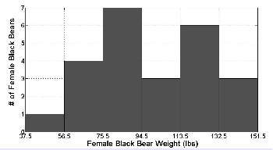
Example 2.2 Histogram for Black Bear Data
1. Histograms
Draw the histogram:
The histogram seems to have two peaks- we say it is bimodal

Slide 17
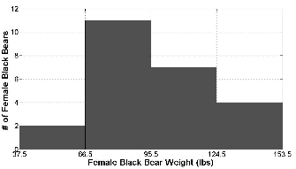
Example 2.2 Histogram for Black Bear Data
1. Histograms
However, when classifying data as bimodal, we must be careful. Suppose we had chosen only four classes. We would have produced this histogram:
This histogram appears to be unimodal.

Slide 18
Example 2.2 Histogram for Black Bear Data
1. Histograms
Finally, we may also consider the relative frequencies for each class:
Class | Lower | Upper | Lower Boundary | Upper Boundary | Frequency | Relative Frequency
1 | 38 | 56 | 37.5 | 56.5 | 1 | 1/24
2 | 57 | 75 | 56.5 | 75.5 | 4 | 1/6
3 | 76 | 94 | 75.5 | 94.5 | 7 | 7/24
4 | 95 | 113 | 94.5 | 113.5 | 3 | 1/8
5 | 114 | 132 | 113.5 | 132.5 | 6 | 1/4
6 | 133 | 151 | 132.5 | 151.5 | 3 | 1/8

Slide 19
Histograms vs Scatter Plots
2. Scatter Plots
Histograms are used to visually display single sets of measurements
In many cases however, the value obtained from a measurement is related to other characteristics or factors affecting the same object being measured; for example:
  a child’s birth weight is related to the mother’s birth weight
  leaf photosynthesis rate is affected by the light level
  the number of eggs laid by a spider may be related to the size of the mother
The objective of a scatter plot is to determine visually whether there appears to be any relationship between two different observations or characteristics of a single biological object

Slide 20
Creating Scatter Plots
2. Scatter Plots
Creating a scatter plot is easy once it is decided which characteristics are to be included
  Each axis is chosen to cover the range of measurements for that observation set
  One measurement is chosen for the horizontal axis and the other for the vertical- which is chosen for which axis which does not matter unless you have some reason to believe that one measurement causes changes in the other, in which case it is conventional to use the horizontal axis for the measurement that is viewed as the causative factor
Then for each object measured, a single point is plotted on the graph at the appropriate coordinates

Slide 21
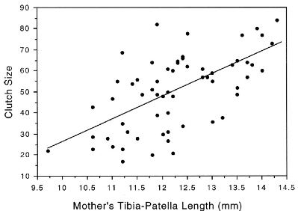
Creating Scatter Plots
2. Scatter Plots
For example, suppose we plot the number of eggs laid by vs the sizes (length in mm) of 38 different spiders:

Slide 22
2. Assignment
Exercises 2.2, 2.3, 2.4, 2.7, 2.9, 2.10

Slide 23
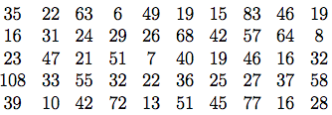
2.3 (a), (e)
Homework
The length of time an outpatient must wait for treatment is a variable that plays an important part in the design of outpatient clinics. The waiting times (in minutes) for 50 patients at a pediatric clinic are as follows:
Construct a histogram by hand using 5 classes.
Solution: First, Determine the width of the classes (CW):
CW = (Range) / (# classes) rounded up to precision of data
= (108 – 6) / 5 = 20.4… => 21

Slide 24
2.3 (a), (e)
Homework
Next, we fill in the table:
Finally, draw the histogram:
Class | Lower | Upper | Lower Boundary | Upper Boundary | Frequency
1 | 6 | 26 | 5.5 | 26.5 | 19
2 | 27 | 47 | 26.5 | 47.5 | 18
3 | 48 | 68 | 47.5 | 68.5 | 9
4 | 69 | 89 | 68.5 | 89.5 | 3
5 | 90 | 110 | 89.5 | 110.5 | 1

Slide 25
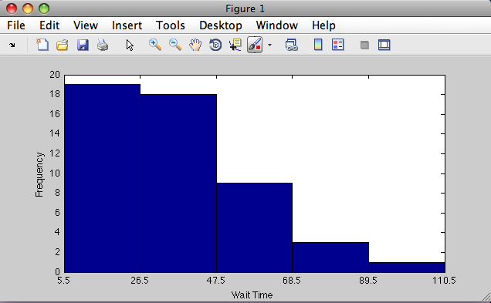
2.3 (a), (e)
Homework

Slide 26
2.4 (b)
Homework
The regulations of the Board of Health specify that the fluoride level in drinking water not exceed 1.5 parts per million (ppm). Each of the 11 measurements below represent average ﬂuoride levels over 15 days in ppm.
0.75 0.86 0.84 0.97 0.94 0.89 0.88 0.78 0.77 0.76 0.82
(b) Construct a relative frequency histogram for this data using an appropriate number of classes (by hand).
Solution: First, Determine the width of the classes (CW):
CW = (Range) / (# classes) rounded up to precision of data
= (0.97 – 0.75) / 4 = 0.055… => 0.06

Slide 27
2.4
Homework
Next, we fill in the table:
Class | Lower | Upper | Lower Boundary | Upper Boundary | Frequency | Relative Frequency
1 | 0.75 | 0.80 | 0.745 | 0.805 | 4 | 4/11
2 | 0.81 | 0.86 | 0.805 | 0.865 | 3 | 3/11
3 | 0.87 | 0.92 | 0.865 | 0.925 | 2 | 2/11
4 | 0.93 | 0.98 | 0.925 | 0.985 | 2 | 2/11

Slide 28
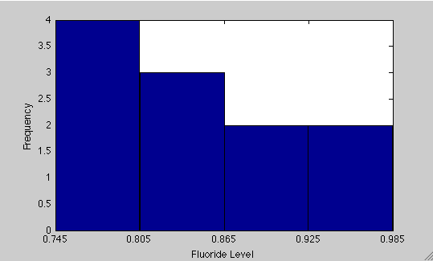
2.4
Homework
Finally, draw the histogram:

