Slide 1
Lecture 3: Bivariate Data & Linear Regression
Introduction
Bivariate Data
Linear Analysis of Data
Freehand Linear Fit
Least Squares Fit
Interpolation/Extrapolation
Correlation

Slide 2
Motivation
1. Introduction
Visual analysis of data, though useful, is limited
We use other methods to determine if there is a sufficiently strong relationship between two measurements to possibly eliminate the necessity of making both measurements
In many fish, there is a very strong relationship between length and body mass, so that measuring the length alone can provide a very good estimate of the individual’s weight
Organisms with determinant growth patterns may also have a very strong relationship between their size and age, so that measurements of individual size may be useful in estimating an individual’s age
In these cases an objective is to determine an equation which allows you to estimate one measurement from another measurement that might be easier to make.

Slide 3
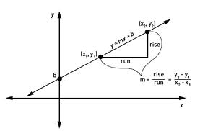
Linear Relationships
1. Introduction
A linear relationship between two measurements is the simplest description of a strong relationship
Knowing one measurement allows you to find the other by just looking at the associated point on the line
Linear relationships arise in many biological situations, particularly if the data are rescaled (see ch. 4) to account for factors that interact in a non-linear manner
Recall the slope-intercept form for a line:
we will need to
go this direction

Slide 4
2. Bivariate Data
Bivariate data are measurements made on two variables per observation
Bivariate data are often displayed as ordered pairs (x₁, y₁), (x₂, y₂), …, (x_{n}, y_{n}) or in a table:
A regression is a formula that describes the relationship between variables. A linear regression is one in which the relationship can be expressed in the equation of a line. In this case, we ﬁnd a line of best ﬁt to describe the relationship.
x | x₁ | x₂ | … | x_{n}
y | y₁ | y₂ | … | y_{n}

Slide 5
Freehand Linear Fit
3. Linear Analysis of Data
See if the data appear to be linearly related
Make a scatter plot of the data. Choose your axes so that the range is approximately the same as that in your data
Which is the horizontal axis and which is the vertical?
If one is the dependent (e.g. body weight depends on age, rather than the reverse), then choose the one that is dependent (weight) as the vertical axis and the independent one (age) as the horizontal axis
If you do not have any reason to expect that one of the measurements is dependent on the other, then choose one and go with it
Eyeball the data and see if there appears to be any relationship. If the scatter plot looks like the points might be described approximately by a line then it is reasonable to proceed with fitting a line

Slide 6
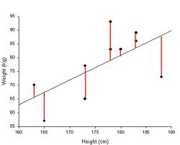
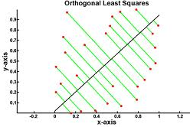
Freehand Linear Fit
3. Linear Analysis of Data
Draw a freehand line that estimates the line of best fit; that is, draw a line through the data, trying to minimize the vertical distance between the line and the points:
vertical orthogonal
Using two points ON THE LINE (not necessarily data points), find the equation of the line.

Slide 7
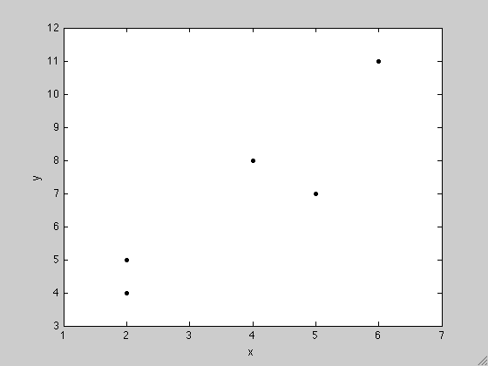
Example 3.1 (Freehand Linear Fit)
3. Linear Analysis of Data
Given the following set of bivariate data, use the freehand method to find a linear equation that fits the data.
Step 1: Make a scatterplot:
The data seem reasonably
linearly related, so we
go to the next step.
x | 2 | 5 | 2 | 4 | 6
y | 4 | 7 | 5 | 8 | 11

Slide 8
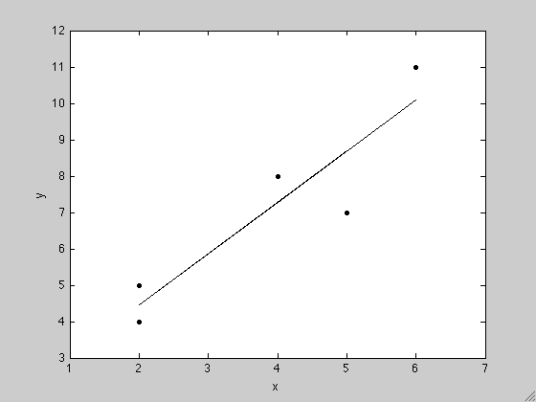
Example 3.1 (Freehand Linear Fit)
3. Linear Analysis of Data
Step 2: Draw a line through the data that attempts to minimize
the (vertical) distance between the line and the points:
Notice that our line contains none of the data points!

Slide 9
Example 3.1 (Freehand Linear Fit)
3. Linear Analysis of Data
Step 3: Next we pick two points ON THE LINE to determine the equation of the line.
Let’s choose (3,6) and (6,10).
Then:

Slide 10
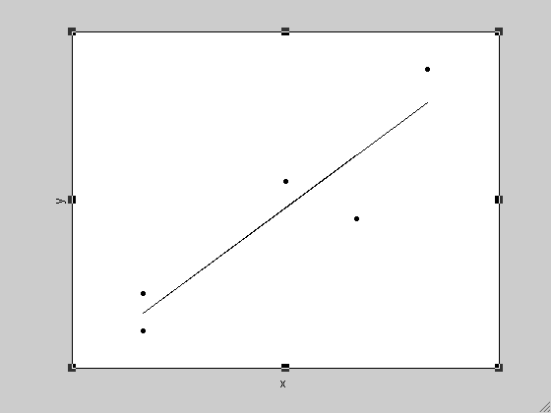
Least Squares Fit
3. Linear Analysis of Data
We want to find and to minimize the sum of errors squared:

Slide 11
Least Squares Fit
3. Linear Analysis of Data
Using some simple calculus techniques, one can easily discover that the best such values are given by
where

Slide 12
Example 3.2 (Least Squares Linear Regression)
3. Linear Analysis of Data
Given the same set of data as before, use the Least Squares method to find a linear equation that fits the data.
Step 1: Find the arithmetic means for x and y:
Step 2: Find S_{xy} and S_{xx}:
x | 2 | 5 | 2 | 4 | 6
y | 4 | 7 | 5 | 8 | 11

Slide 13
Example 3.2 (Least Squares Linear Regression)
3. Linear Analysis of Data
Step 3: Find and :
Step 4: Write down the equation:
Compare with our freehand approximation:

Slide 14
Interpolation & Extrapolation
3. Linear Analysis of Data
Our linear least squares fitted line is a simple mathematical model for the dataset. Models can be used to describe relationships and make predictions about some physical system.
As an example, we can use the linear equation to predict y-values for certain x-values:
If the given x-value lies within the range of x-values for our dataset, then the predicted y-value is an interpolation
If the given x-value lies outside the range of x-values for our dataset, then the predicted y-value is an extrapolation

Slide 15
Interpolation & Extrapolation: Example 3.3
3. Linear Analysis of Data
Using the data and best fit line found in Example 3.2, estimate the y value that would correspond with the following x values: (a) x = 5, and (b) x = 10. Which corresponds with performing an interpolation and which with an extrapolation?
Solution:
x=5: interpolation
x=10: extrapolation

Slide 16
4. Correlation
We’d like to know if our LSR is good.
Two sets of measurements are “correlated” if there appears to be some relationship between them
In this section we present formulae applicable only for linear correlation
Correlated does not imply causally related; e.g. leaf length and width

Slide 17
Correlation Coefficient
4. Correlation
The correlation coefficient rho is given by:
This value will always be between -1 and 1
If ρ = -1, data are perfectly negatively correlated; if close, highly negatively correlated
If ρ = 0, data are uncorrelated; note: this only means they are not linearly related
If ρ = 1, data are perfectly positively correlated; if close, highly positively correlated
ρ² x 100 tells us the percent of the variance accounted for by the LSR

Slide 18
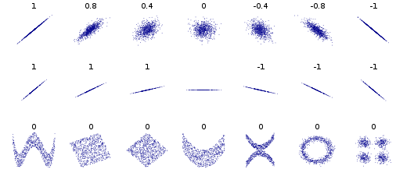
Figure 3.1
4. Correlation
Various sets of data with their corresponding correlation coefficient shown above each data set. Notice in the bottom row that there can be a correlation in the data, but the value for the correlation coefficient ρ is zero because there is not a linear correlation

Slide 19
Example 3.4
4. Correlation
How correlated is the data presented in Example 3.1?
In order to use the formula, we need to calculate S_{yy}:
We have, then, the correlation coefficient:
highly correlated
Finally, ρ² = .8464, so 85% of the variance in the dataset is accounted for by the LSR line

Slide 20
Homework
Chapter 1: 1.2 - 1.5
Chapter 2: 2.2–2.4, 2.7, 2.9, 2.10
Chapter 3: 3.3, 3.4, 3.9

Slide 21
Exercise 3.4 (d)
Homework
The average length and width of various bird eggs are given in the following table.
Step 1: Find the arithmetic means for x and y:
Step 2: Find S_{xy} and S_{xx}:
x | 5.8 | 1.5 | 2.3 | 1.0 | 3.3
y | 8.6 | 1.9 | 3.1 | 1.0 | 5.0

Slide 22
Exercise 3.4 (d)
Homework
Step 3: Find and :
Step 4: Write down the equation:

Slide 23
Exercise 3.4 (e)
Homework
In order to use the formula, we need to calculate S_{yy}:
We have, then, the correlation coefficient:
highly positively correlated
Finally, ρ² = .9975, so 99.75% of the variance in the dataset is accounted for by the LSR line

